Slide 1




Notes:
*

Slide 2


UI ENGINEERING STUDIO
UI Engineering Studio. Day 11 Bootcamp: React

Slide 3

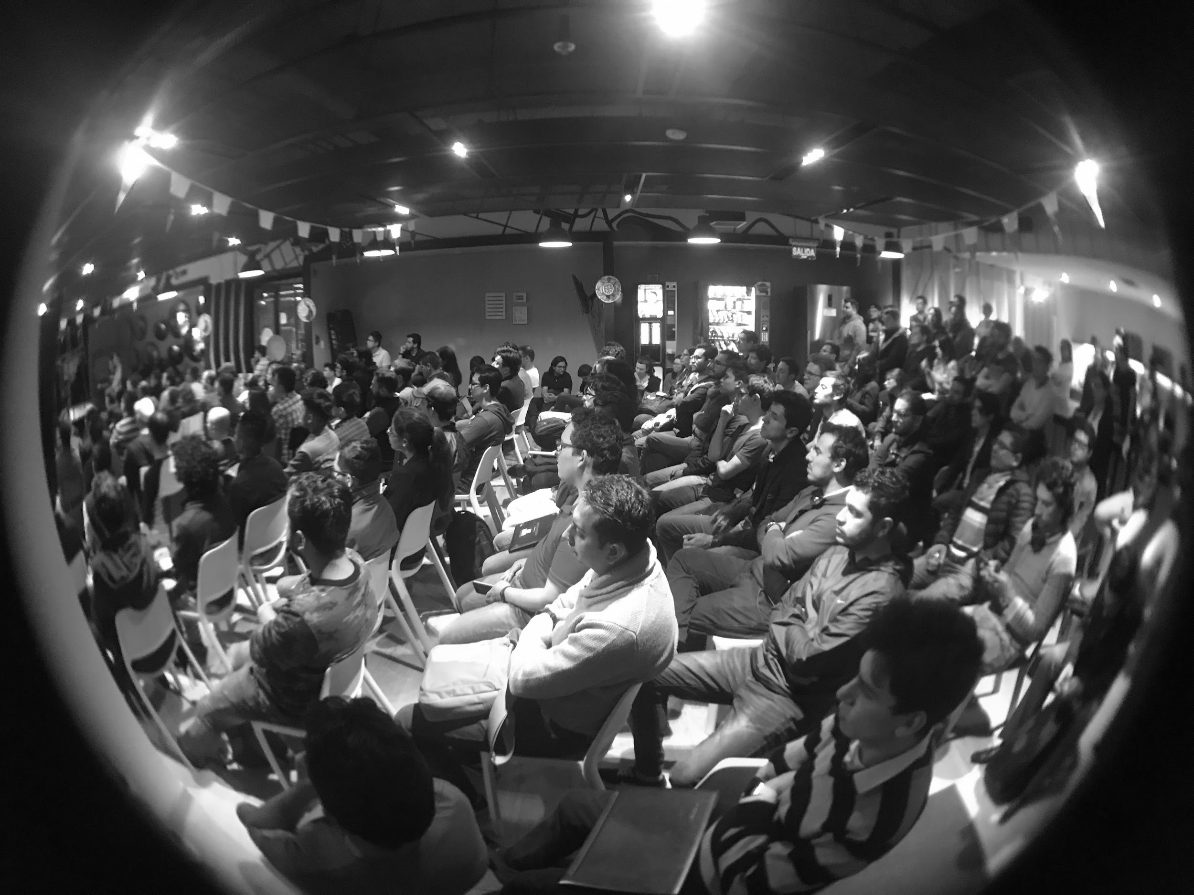
UI ENGINEERING STUDIO
React
is a declarative, efficient, and flexible JavaScript library for building user interfaces. It lets you compose complex UIs from small and isolated pieces of code called “components”
- https://reactjs.org
SPA
Routing

Slide 4
UI ENGINEERING STUDIO
UI Boot Camp: React SPA: Single Page Application
“Web application or web site that interacts with the user by dynamically rewriting the current page rather than loading entire new pages from a server. This approach avoids interruption of the user experience between successive pages, making the application behave more like a desktop application. In an SPA, either all necessary code – HTML, JavaScript, and CSS – is retrieved with a single page load, or the appropriate resources are dynamically loaded and added to the page as necessary, usually in response to user actions. The page does not reload at any point in the process, nor does control transfer to another page…”

Slide 5

UI ENGINEERING STUDIO
UI Boot Camp: React Routing: React Router
Declarative Routing for React
Static Routing vs Dynamic Routing
Notes:
Enrutamiento estático: Usted declara sus rutas como parte de la inicializción de la app, antes de que el renderizado se ejecute
Enrutamiento dinámico: El enrutamiento se hace cuando la aplicación se renderiza, no es una configuración o convención fuera de la aplicación. Esto significa que casi todo es un Componente en React Router

Slide 6
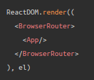
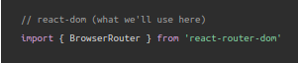
UI ENGINEERING STUDIO
UI Boot Camp: React Routing: React Router - Step by step
Grab yourself a Router component for the environment you’re targeting and render it at the top of your app

Slide 7
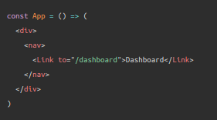
UI ENGINEERING STUDIO
UI Boot Camp: React Routing: React Router - Step by step
2. Grab the link component to link to a new location:

Slide 8
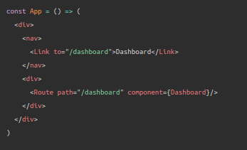
UI ENGINEERING STUDIO
UI Boot Camp: React Routing: React Router - Step by step
3. Render a Route to show some UI when the user visits /dashboard.

Slide 9
UI ENGINEERING STUDIO
UI Boot Camp: React Routing: React Router
https://codepen.io/LeHoangNguyen/pen/ejzYzx?page=1&

Slide 10

UI ENGINEERING STUDIO
UI Boot Camp: React Homework!
We’re going to continue with the TODO list.
Let’s implement React Router :D

Slide 11
Notes:
*

